Slide 1

Niagara Overview
Durvin Sandiford
Tridium EMEA

Slide 2






Tridium’s Story
1995
Engineers & Graduates
1999
Niagara created
2005
Acquired by Honeywell
Over 1 Million Niagara Instances
20,000 +
Trained Engineers
50 +
Countries
Notes:
Details about Tridium History. In the mid 1990’s Tridium was formed to solve the problem of integration.

Slide 3











Why People Decide on Niagara
Open vendor
Grows with you
Use the technology you want
Rich developer community
Enhance your existing investment
Keep what you have
Rich normalised data
No technology lock in
Global reach, locally provided

Slide 4
Value Propositions
Open, no lock into a specific manufacturer for future system upgrades.
Browser Based User Interface using HTML 5, no Browser Plugin required.
All open protocols included e.g., BACnet, KNX, LON, M-Bus, Modbus, MQTT, SNMP etc.
Can use Multiple Protocols on one platform e.g., either open and/or legacy types.
JACE 8000 with or without Wi-Fi option.
Extensive list of open and third-party protocol drivers available.
One engineering tool for Integration, Visualisation, Cyber Security, Enterprise Data Exchange, Backup and Analytics.
Flexible and secure solution with excellent cyber-security for local and/or remote access.

Slide 5
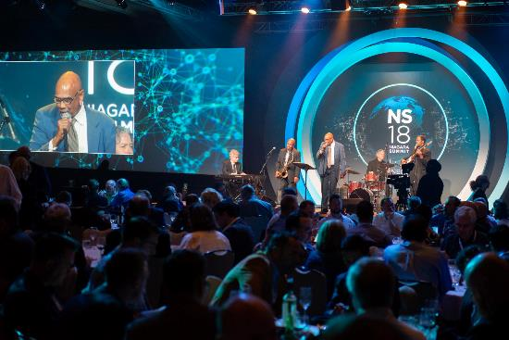
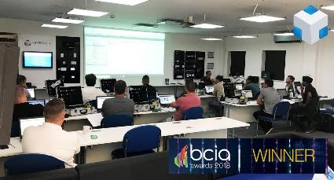
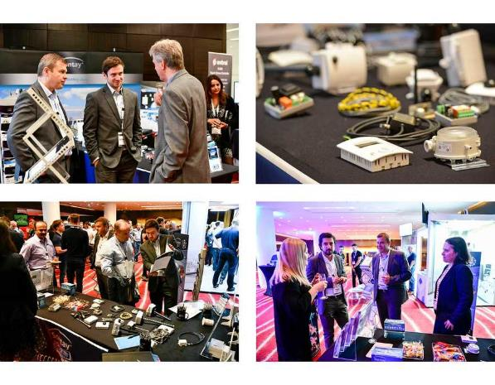
The Niagara Community
Over 1 Million instances Niagara installed
Thousands of certified Niagara professionals
Hundreds of system integrators in 50 countries
Dozens of developers and legacy drivers
95 OEMs with 113 Niagara-based products
New Master Systems Integrators (MSI)
Notes:
Niagara is the only truly open IoT platform which is delivered, supported and built upon by an independent community of installers, software developers and OEM’s. Tridium provide the secure and maintained Niagara core platform while our partners are free to develop new applications and services on top of the platform. The result is that any end user can have a variety of companied to support their buildings and employ developers to build upon Niagara for their own needs.

Slide 6
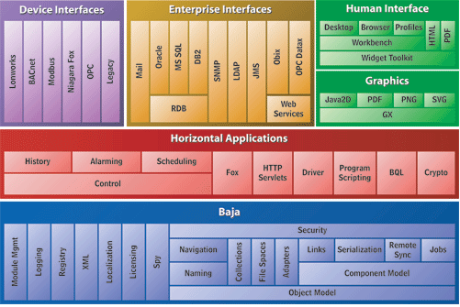
The Niagara Framework
Integration Platform
QNX Operating System
Normalised data
Buildings, cities, energy, DCM
Open Vendor & Open Technology
3rd Party Eco-system
Keep what you have
Reseller, OEM’s, Portability
Over 200 drivers and growing
Cloud, on prem, edge
Notes:
The Niagara framework is a powerful and scalable IoT platform which is truly open through supporting open protocols, a library of legacy drivers,

Slide 7
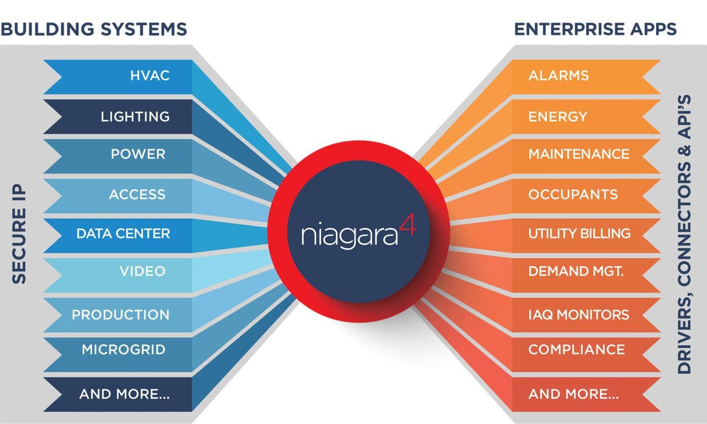
Niagara Framework Easily Connects Intelligent Systems
A Software framework that allows you to preserve legacy systems investments, save on development costs and reduce time to market
Notes:
Via multiple drivers, all data from the building sub systems can be pulled into the Niagara platform and ‘normalized’. Within Niagara, all systems can be integrated into a single homogenous ‘smart’ building, working as one. Additionally, as Niagara is also a web server it can easily connect into 3rd part enterprise systems.

Slide 8

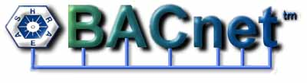







Open Integration Standards
PLC’s
Modbus®
IO Modules
IT Devices
Notes:
Core open protocols loaded in the image of Niagara.

Slide 9
















Supporting Legacy & Proprietary Drivers
Notes:
Able to connect to legacy products, some of which are end of life and before IP.

Slide 10
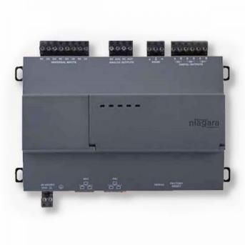
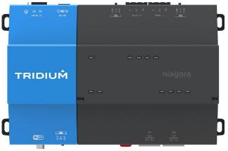
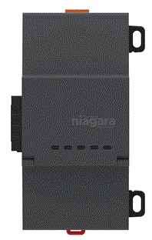
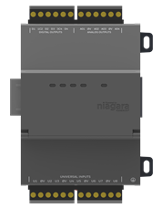
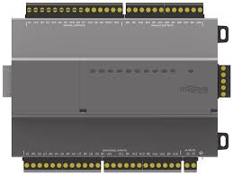
Product Line Up - Hardware
JACE
Full Niagara software
Connects to any PLC
Connects to any IO
Typically in an electrical panel
Expansion Modules
LON, RS232, RS485
IO Modules
16 or 34 connections
Edge10
Full Niagara software
Onboard IO
ACE – fast boot
Notes:
Able to connect to legacy products, some of which are end of life and before IP.

Slide 11
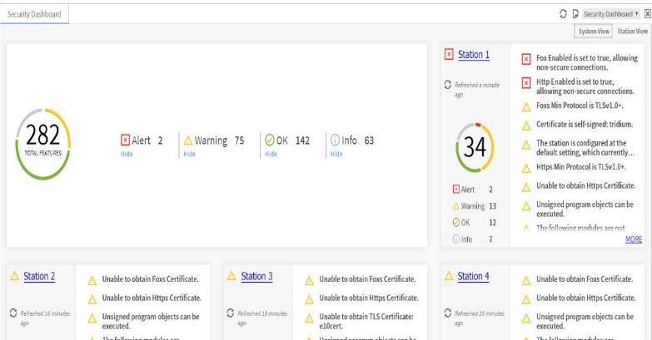
Cyber Security
Security Dashboard
Customizable authentication schemes
Authentication of users with strong credentials by default
802.1x
Manage user roles and permissions with tags
Role-Based Access Control (RBAC) for easy permissions configuration
Configurable Authentication based on connection type
Enterprise identity and access management systems (LDAP, Kerberos) integration
Authentication requires users to choose strong credentials as both data in motion and sensitive data
Digital signatures to ensure application integrity
NIST-validated FIPS 140-2 Level 1 option
Dedicated cybersecurity team focused on continuous security improvements
All user actions and security-related events are recorded in Niagara’s audit log for traceability
BACnet/SC – From Version N4.11

Slide 12
Global Support
Dedicated global account manager & regional managers
Managed introductions to local installers / partners
Product training in local language
Roadmap updates
Global technical workshops
Support global standards with local installers
Standardised UI templates (via pro services)
Enterprise SMA – all licence updates under one roof
Back Up as a Service – Cloud based back ups
Product development
Notes:
A typical deployment. Niagara can pick up local hard wired devices, integrate to IP based systems (CCTV), Server based software (HR, SAP, Access Control etc…).
Niagara can also control other BMS controllers if they need replacing as a retro fit.

Slide 13
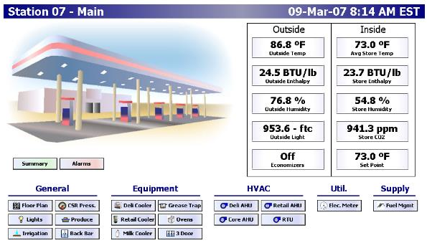
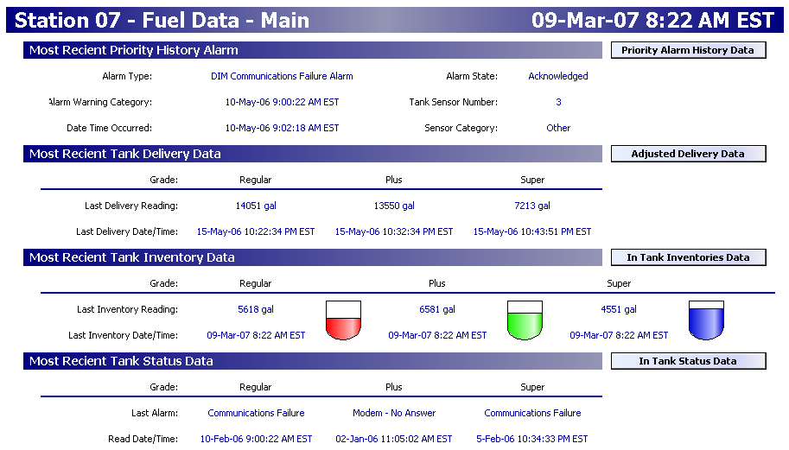
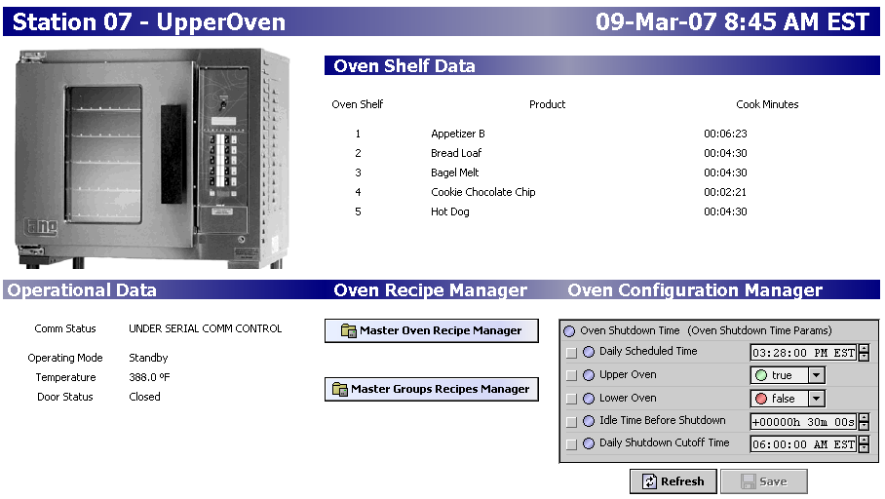
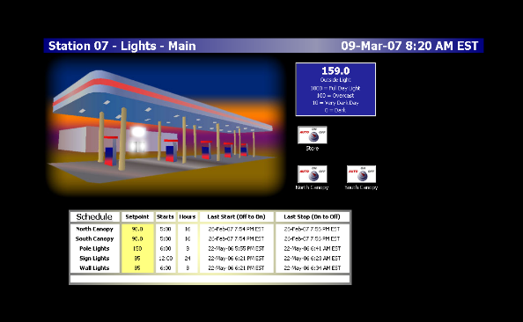
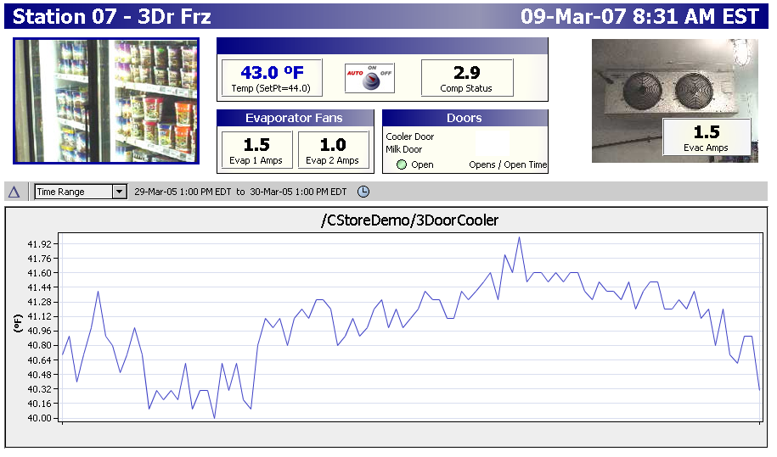
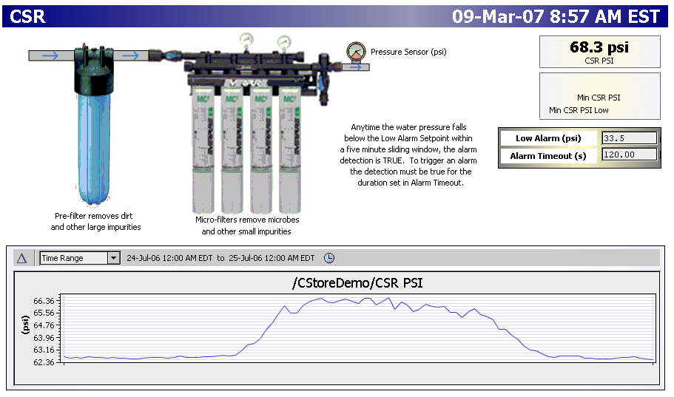
User Examples of Advanced Systems
USA Gas Station & Retail – circa 500 sites
Refrigeration compliance
Fuel level monitoring in real time
Oven management
Notes:
A typical deployment. Niagara can pick up local hard-wired devices, integrate to IP based systems (CCTV), Server based software (HR, SAP, Access Control etc…).
Niagara can also control other BMS controllers if they need replacing as a retro fit.

Slide 14
Thank you
Tridium EMEA

